Slide 1
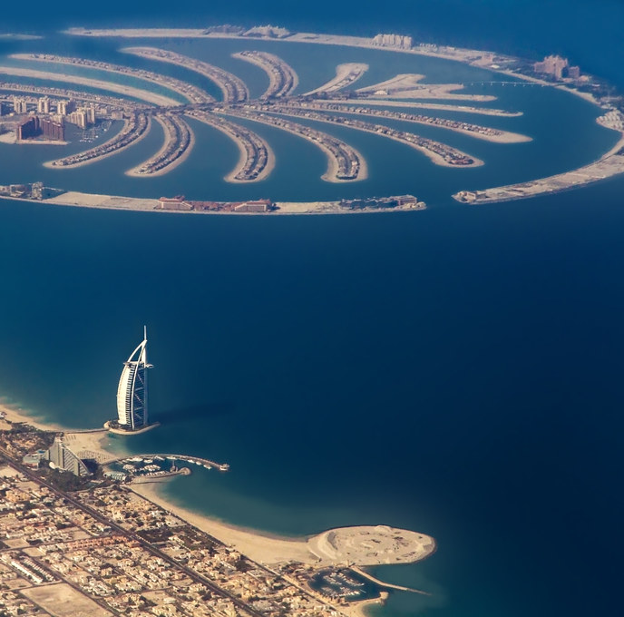


The Alba Data-Driven Strategies
Created by Group 8

Slide 2

The Alba: Palm Jumeirah Entry Strategy
Business Problem
How can The Dorchester Collection successfully enter the Palm Jumeirah luxury hotel market while optimizing pricing strategies and enhancing guest satisfaction to maximize long-term profitability?
Objective & Approach
Analyze General Market Trends
Understand Customer Preferences
Conduct Competitor Analysis

Slide 3
Data Sources overview
1
Dubai Statistics Center
2
Hotels.com
Sourced data on tourism, and Dubai Luxury Hotel market.
Web scraping provided insights on hotel pricing and ratings.
3
Booking.com
4
Google Places API
Web scraping gave information on luxury apartment rental rates.
Collected data about points of interest and customer reviews in specifed regions within Dubai.

Slide 4
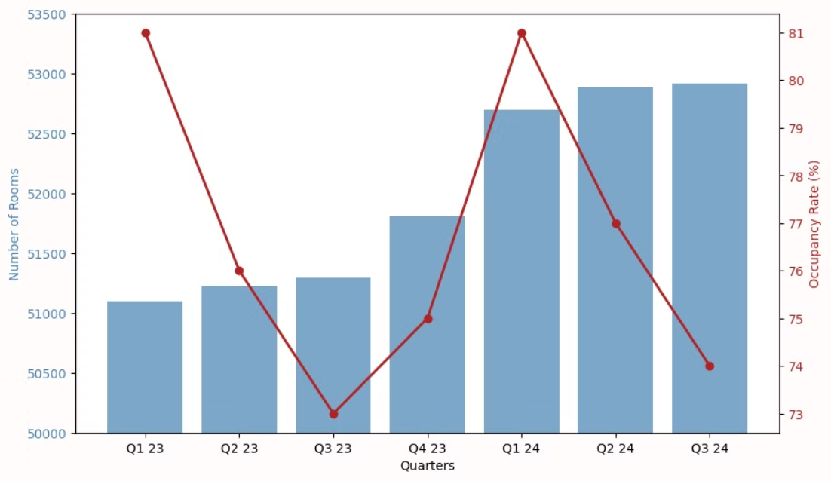

Dubai 5-Star Hotel Market Overview
5 Star hotel rooms have increased in capacity in every quarter.
Occupancy rate follows a clear seasonal trend which peaks in the First Quarter of each year.
Source: Government of Duabi, Dubai Statistics Center

Slide 5
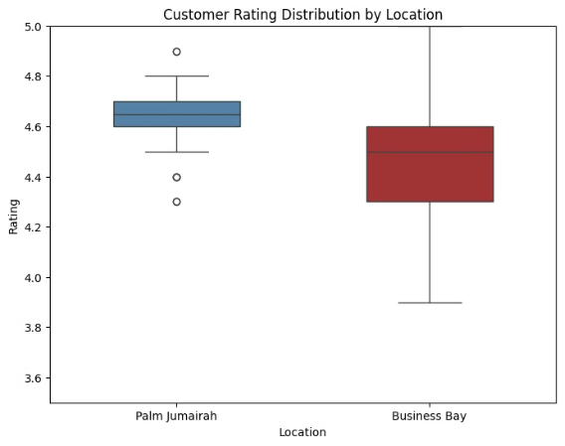
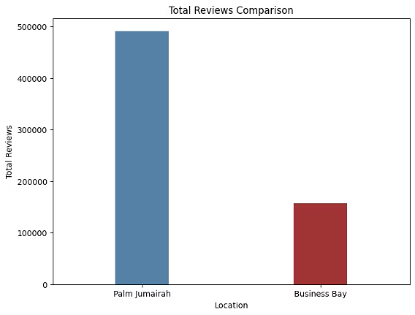
Customer Preferences Comparison
Palm Jumeirah vs. Business Bay
Recommendations
Consistent high-quality service by implementing regular service training programs
Differentiation through unique luxury experiences, personalized service such as: personal butlers
Seamless digital and in-person service integration where the hotel system set guest preferences: room temperature, pillow type

Slide 6
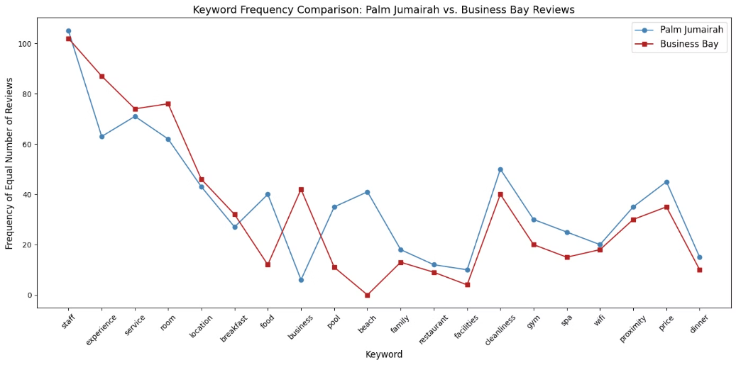
Customer Preferences Comparison
Palm Jumeirah vs. Business Bay
Recommendations
Emphasizing resort-style luxury by highlighting direct beachfront access, free spa access
Invest in fine dining by partnering with renowned international brands such as Zuma and Novikov
Tailored wellness program, featuring healing rituals, private fitness training, and nature-immersive spa treatments.
Design & Atmosphere: Softer, more tranquil ambiance compared to the city-luxe vibe of The Lana.
Source: Google Cloud API

Slide 7
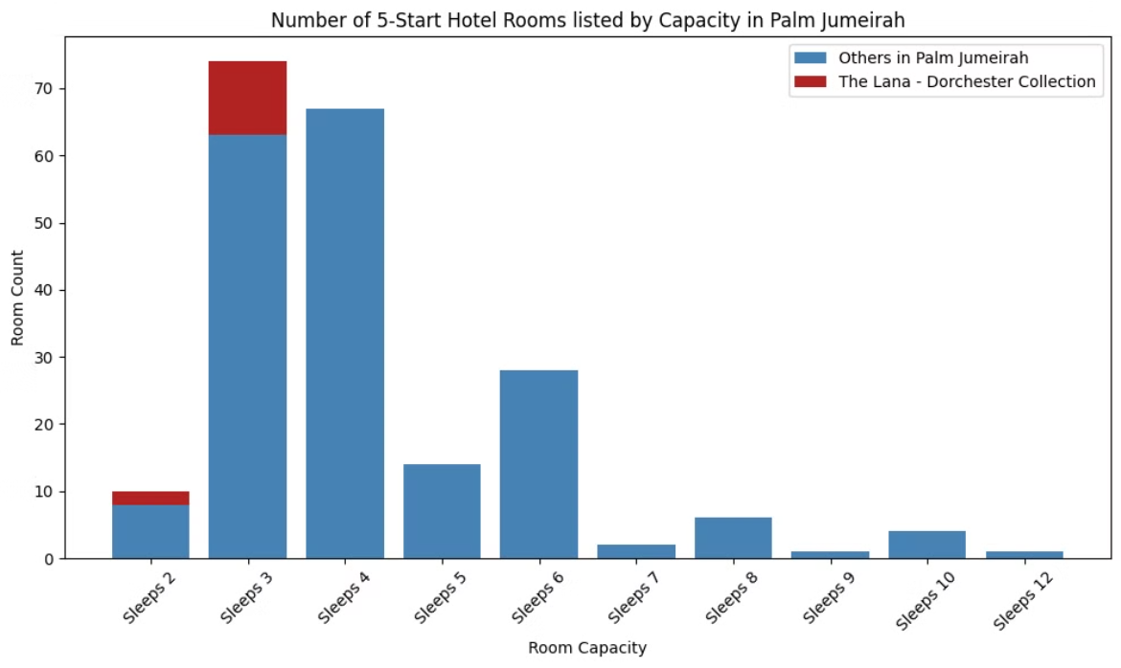

Room Capacity Comparison
This graph shows the total number of rooms available at Palm Jumeirah and The Lana, categorized by accommodating capacity.
Customer tend to visit Palm Jumeirah in bigger group size than The Lana in the Business Bay.
Source: Hotels.com

Slide 8
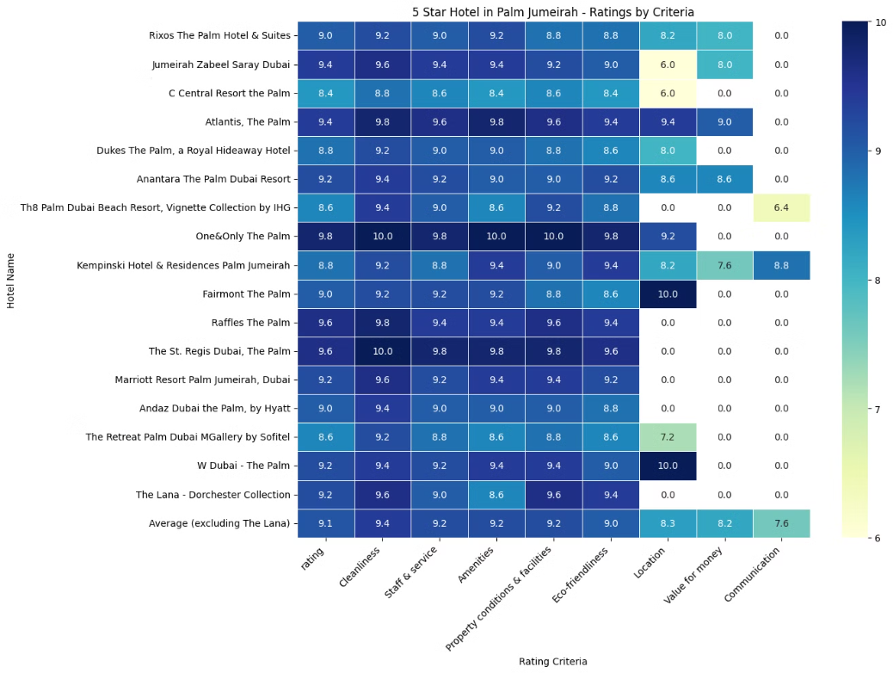

5 Star Hotel Competitor Analysis in Palm Jumeirah
The Lana has a lower Amenities category score, this category seems to especially competitive in the Palm Jumeirah area.
Highly competitive region in terms of customer satisfaction, with the leading luxury hotel being 'The one & only'.
Source: Hotels.com

Slide 9
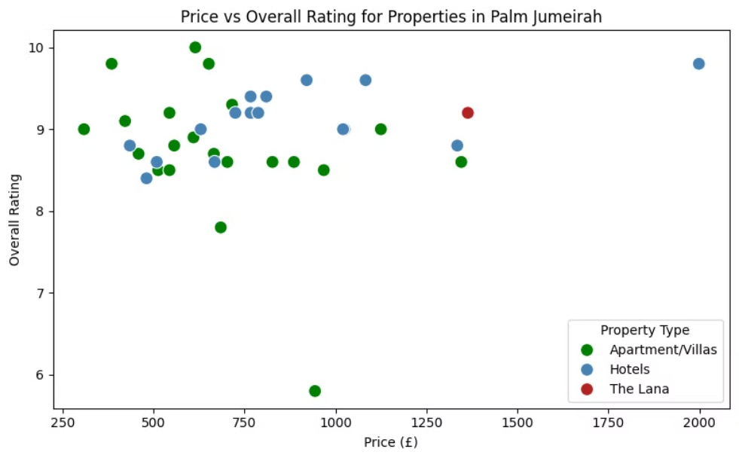
Competitor Analysis: Hotels vs. Apartments in Palm Jumeirah
This chart compares 5-star hotels and luxury apartments on Palm Jumeirah based on customer ratings and nightly prices.
One & Only Hotel is leading the luxury market in price and quality.
This emphasizes on the importance of keeping customer satisfaction score above the average considering The Lana's pricing position
Source: Hotels.com and Booking.com

Slide 10



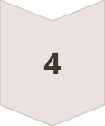


Insights & Recommendations
Luxury Hotel market is growing, but occupancy rate is Cyclical with peaks in Q1.
As a premier luxury destination, Palm Jumeirah demands consistently high-quality service, unique luxury experiences,
and personalized services.
Palm Jumeirah attracts guests seeking exceptional dining, world-class pool and beach facilities, and luxurious spa experiences.
The Lana Dorchester Collection has a weak point in Amenities. The Alba must excel in this field to succeed.
Unlike the Business Bay, Palm Jumeirah has a wider offering for touristic accommodation like Villas and Apartments, therefore the Alba should focus on accommodating larger groups of people.
To decide on a price range, we recommend comparing the services and amenities provided to the other luxury hotels in the Palm Jumeirah such as the 'One & Only The Palm'.

Slide 11

Future Opportunities for Deeper Insights
Improving pricing analysis by capturing price movements dynamically throughout the year.
Use Social Media APIs to find the popularity of certain areas within Dubai to capture tourist attractions.
Capture customer insights using NLP models from reviews and posts to create sentiment analysis.

